Slide 1
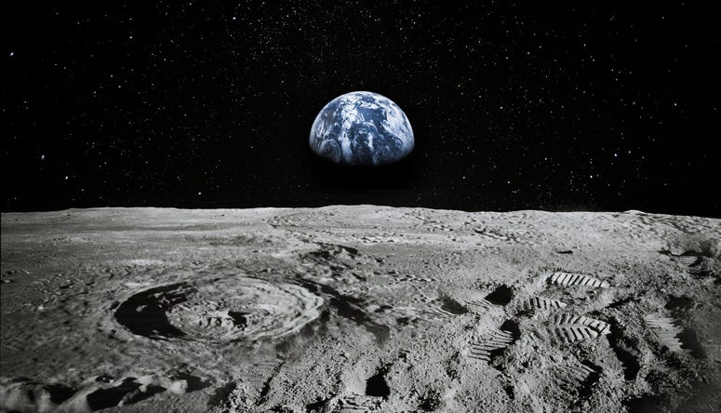
LUNAR LANDING PAYLOAD CRANE
Alanna Black | Jayson Dickinson | Christina Morrow | Ryker Mullinix
TEAM 517

Slide 2
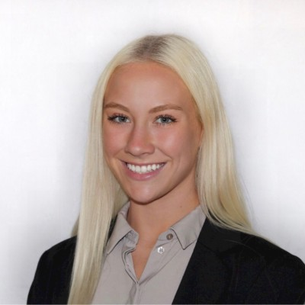
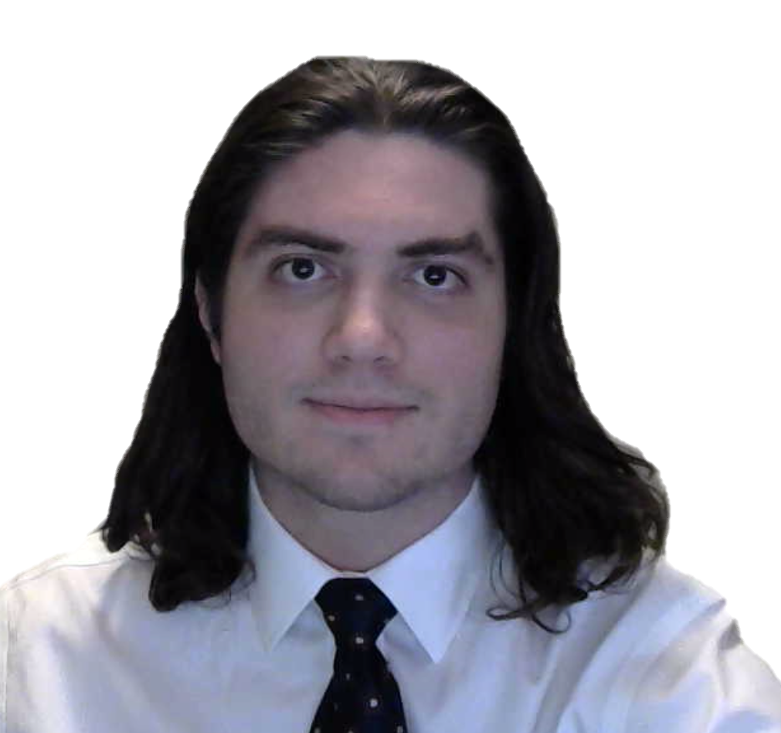
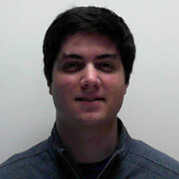
Meet Team 517
Alanna Black
Jayson Dickinson
Christina Morrow
Ryker Mullinix
Robotics &
Controls Engineer
Project Manager &
Fluid Dynamics Engineer
Design & Test
Engineer
Materials Engineer
Christina Morrow

Slide 3
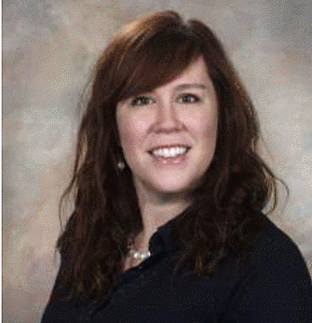
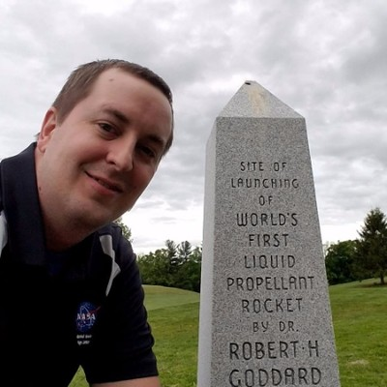
Sponsor & Advisor
Rachel McCauley
Justin Rowe
Dr. Eric Hellstrom
NASA Marshall Space
Flight Center
NASA Marshall Space
Flight Center
FAMU-FSU
College of Engineering
Christina Morrow

Slide 4
Project Objective
The objective of this project is to offload the LSMS (Lightweight Surface Manipulation System) from the CLPS (Commercial Lunar Payload Services) lander onto a platform.
Christina Morrow
Notes:
The objective of our project is to offload the LSMS from the CLPS lander onto a platform on the lunar surface.
The LSMS, which stands for “lightweight surface manipulation system” is the payload crane that NASA has developed.
The CLPS lander was developed by “Commercial Lunar Payload Services”.

Slide 5
Project Background
NASA Plans for
Lunar Base
NASA Developed Payload Crane
v
v
Artemis Mission
Announced
Design Payload Crane Off-loader
Christina Morrow
Notes:
To give a little background context for our project
NASA, has been dreaming and planning of our return to the moon. And setting up a lunar base.
The Artemis mission was announced in May of 2019, with those goals.
NASA has developed a payload crane (which is the LSMS). This crane would be used to unload all of the payloads on the lander and then help set up the lunar base, and more.
So, this is where our team comes in. Currently, the LSMS is fixed to the CLPS moon lander, with no way of detaching or offloading it. So, it’s purpose is very limited because it can only reach things to take them off of the lander.

Slide 6
Motivation
Christina Morrow
Notes:
The driving motivation behind the project, is get the LSMS into a position where it can have a wider application, So here we kind of show it helping to set up the lunar base. But NASA also plans to use it in excavation and 3D printing, just a lot of really creative applications for the LSMS. But it’s all dependent on getting it off of the CLPS lander and down onto the lunar surface.

Slide 7
Motivation
Christina Morrow

Slide 8
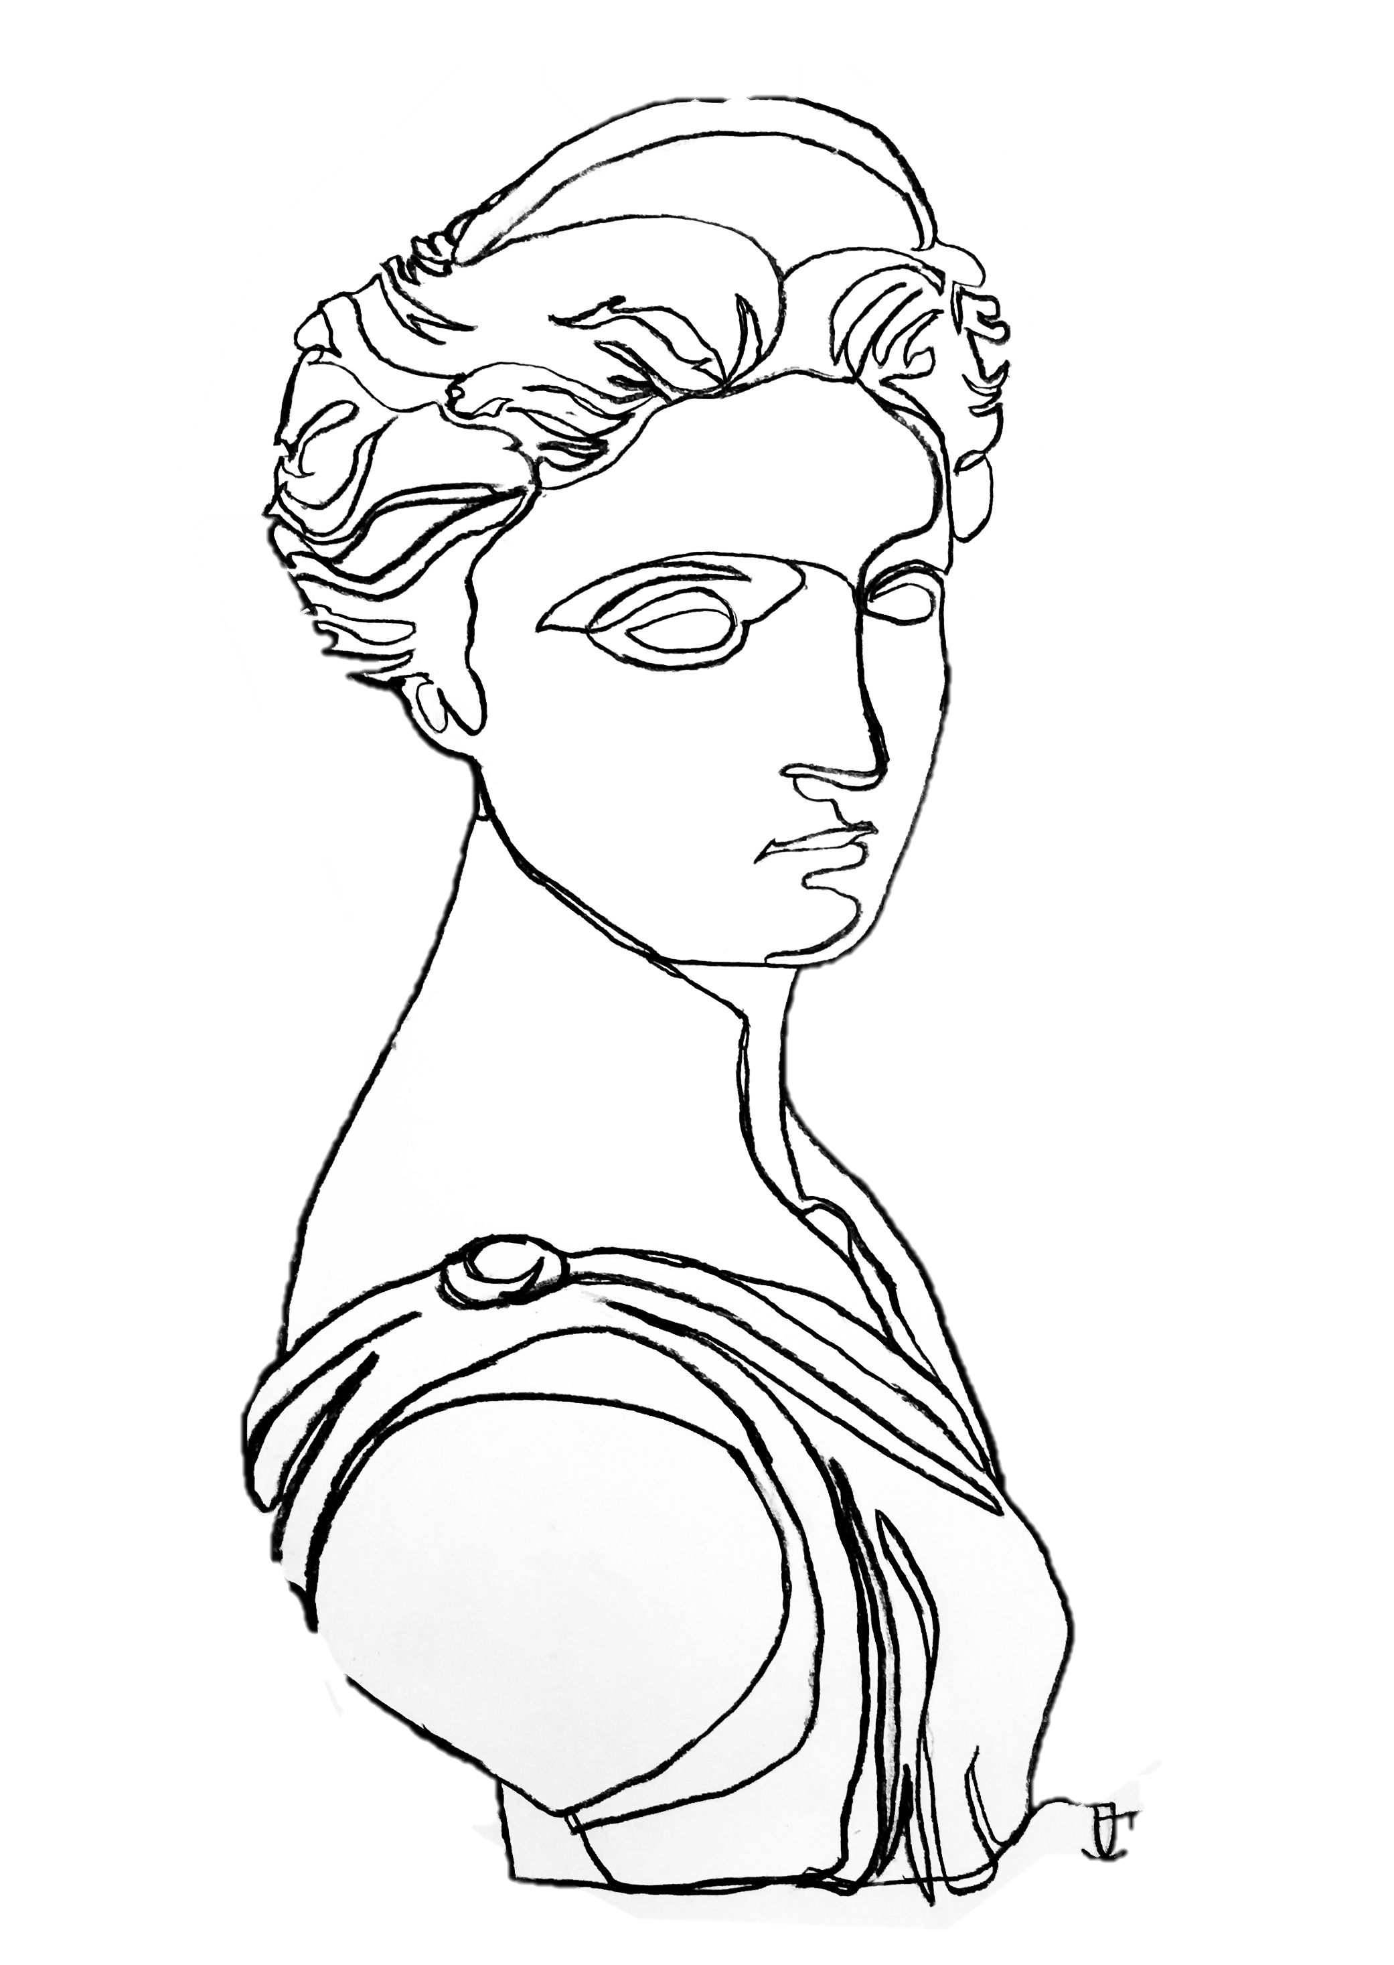
Artemis Background
Goddess of the Hunt
Christina Morrow
Notes:
So I mentioned the Artemis missions, just some fun facts about Artemis from Greek mythology. She’s is the goddess of the hunt, her symbols are the bow and arrow. And NASA has used this symbology in creating their program patch. It’s shaped like an arrow head, with a silver background, representing her silver arrows.
ALSO, if you want to mention (don’t have to) that Artemis is the twin sister of Apollo (The first mission to the moon was the Apollo mission)

Slide 9
Artemis Background
Goddess of the Hunt
Artemis Program Patch
Christina Morrow
Notes:
So I mentioned the Artemis missions, just some fun facts about Artemis from Greek mythology. She’s is the goddess of the hunt, her symbols are the bow and arrow. And NASA has used this symbology in creating their program patch. It’s shaped like an arrow head, with a silver background, representing her silver arrows.
ALSO, if you want to mention (don’t have to) that Artemis is the twin sister of Apollo (The first mission to the moon was the Apollo mission)

Slide 10
A
R
R
O
W
AUTOMATED AND RANGED RELOCATION OF THE LSMS FOR WIDER APPLICATION
Christina Morrow
Notes:
So our team thought it would be a creative way of tying our project into the mission as a whole, if we named our eventual design ARROW, which stands for automated and ranged relocation of the LSMS for Wider application. So if you hear us refer to the ARROW, we are talking about our eventual design for the offloader

Slide 11
Assumptions
Project Scope
THE ARROW HAS ACCESS TO POWER VIA THE CLPS LANDER
LSMS WILL SEND READY SIGNAL TO ARROW
REUSABILITY IS NOT A CONCERN
Christina Morrow
Notes:
To get started, we had to find the bounds of our project, so we have a list of assumptions that allow us to do that.
First, the ARROW has access to power via the CLPS lander. So we are not concerned with providing power, power is provided for us.
Second, the LSMS will send ready signal to the ARROW, really what this means is that to some degree, there is a line of communication between the LSMS and the ARROW, so that they can work in junction.
Next, is that reusability is not a concern. I kind of touched on it earlier, but again, the big motivation is to enable to LSMS to be reusable because it’s such a valuable asset.

Slide 12
Assumptions
LSMS CAN DOCK TO LUNAR PLATFORM
Project Scope
ENVIROMENTAL FACTORS ARE NOT A CONCERN
LSMS AND ARROW LOCATION ON LANDER ARE AT THE DISCRETION OF THE DESIGN TEAM
IN-SPACE ASSEMBLY WILL NOT BE REQUIRED, IN-SPACE EXTRA-VEHICULAR ACTIVITY (EVA) ASSEMBLY WILL NOT BE REQUIRED.
Christina Morrow
Notes:
Our next assumptions is that the LSMS can dock to the Lunar platform. So we are not concerned with the docking mechanism.
Next, we have that environmental factors are not a concern. Typically this would definitely not be true, especially when designing something meant to go work on the moon. But because this is such a proof-of-concept project, we’ve been given a lot of leeway and have been told that we can neglect environmental factors and focus primarily on the mechanism itself.
Next assumptions is that the LSMS and ARROW location on the lander are at the discretion of the design team. Again, we’ve been given some leeway in regards to keep-out zones and things like that, so we are able to orient them in a way that works best for our design.
Last is that in-space assembly will not be required and in-space extra-vehicular activity assembly will not be required. Broken down, what that basically means is that the ARROW will be fully assembled at launch. No extra assembly will be required.

Slide 13
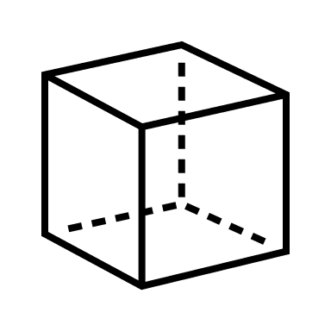
Key Goals
AUTONOMY
OFFLOAD LSMS
SCALABILITY
Christina Morrow
Notes:
So through dialoging with our sponsor, we’ve determined that the key goals of our project are that the ARROW should operate autonomously, it needs to successfully offload the LSMS, which weighs 25 lbs on the moon. The ARROW will also need to have a scable design, to accommodate the various sizes of the LSMS, but weigh no more than 20 lbs on earth.

Slide 14
Targets & Metrics
MOTION
COMMUNICATION
POWER
SUPPORT
Ryker Mullinix
Notes:
Last design review, we talked about our functional decomposition process, breaking down the needs of our project into different system, and further into viable functions in each system.
These were the four main system that came out of that process: Motion, Support, Power, and Communication.
So now, we’ve broken it down even further and assigned a target and metric to each of the functions.

Slide 15
Targets & Metrics
z
X-AXIS
Y-AXIS
Z-AXIS
Move about Axes
0°
0°
90-180°
x
Relocate the LSMS
0.525 m
0.225 m
0.75 m
y
Ryker Mullinix
Notes:
Looking at the motion functions, we’ve established that the arrow will move 180 degrees about either the X or the Y axis and 360 degrees about the z-axis.
It was in our assumptions that the LSMS will be attached to the CLPS peregrine lander for the Artemis mission. Based on the dimensions of the Peregrine Lander, we know that the LSMS needs to be relocated 0.525m in the x direction, 0.255m in the y direction, and 0.75m down to the ground (z direction)

Slide 16
Targets & Metrics
Decrease LSMS
Position Error
±2.54 cm
±10 deg
Secure LSMS
110 N
Release LSMS
±2.54 cm
Scale for Variable
LSMS Size
1:1
Ryker Mullinix
Notes:
These are the functions related to our support system.
Our first function was to decrease the LSMS position error. These values are based on a paper published by our sponsor with position tolerances related to the LSMS connection to an end-effector. So we assigned those same positional tolerances to relocating the LSMS. We want to get within 2.54cm of our XY goal and within 10 degrees alignment.

Slide 17
Targets & Metrics
Decrease LSMS
Position Error
±2.54 cm
±10 deg
Secure LSMS
110 N
Release LSMS
±2.54 cm
Scale for Variable
LSMS Size
1:1
Ryker Mullinix
Notes:
Next, we need to secure the LSMS. We quantified this in terms of the grip force needed to secure and support movement of the LSMS. This value of 1334 Newtons is based off of the force needed to lift the scaled LSMS that we’ll be using for our demonstration, which weighs around 150 lbs in earth gravity.

Slide 18
Targets & Metrics
Decrease LSMS
Position Error
±2.54 cm
±10 deg
Secure LSMS
110 N
Release LSMS
±2.54 cm
Scale for Variable
LSMS Size
1:1
Ryker Mullinix
Notes:
Next, we have to Release the LSMS. We quantified this in terms of a clearance value. We want to make sure that the ARROW has at least a 2.54cm clearance on all sides of the LSMS when the LSMS begins to move away from the ARROW.

Slide 19
Targets & Metrics
Decrease LSMS
Position Error
±2.54 cm
±10 deg
Secure LSMS
110 N
Release LSMS
±2.54 cm
Scale for Variable
LSMS Size
1:1
Ryker Mullinix
Notes:
Lastly, we need to scale for variable LSMS sizes. *******************************************************

Slide 20
Targets & Metrics
Receive Power
1800 Watts
Convert Power to Torque
276 Nm
Ryker Mullinix

Slide 21
Targets & Metrics
Receive Power
1800 Watts
Convert Power to Torque
276 Nm
Ryker Mullinix
Notes:
We also need to convert that power to torque, based on the weight of the LSMS on the moon (25 lbs), we know that we’ll need 276 Newton Meters to move the LSMS.

Slide 22
Targets & Metrics
Transmit Signal
2.4 GHz
Receive Signal
2.4 GHz
Transduce Signal
120 Volts
Process Signal
18 ms
Ryker Mullinix
Notes:
This is our Communication System, most of these target values are based of values similar to what you’d see with RC cars. Through talking with out sponsor, he said that this was a perfectly fine assumption to make. It’s not far from what they’re actually using and for a proof-of-concept project, they would suffice.
So based on that, we’ll need 2.4 Ghz to transmit a signal. This is needed because the ARROW will need to communicate with the LSMS.
We’ll also need 2.4 Ghz in to receive a signal from the LSMS.
120 Volts will be needed to transduce the signal into something meaningful.
Lastly, we’re shooting for a processing time of 18ms. Based on the research we did about RC car, 18ms seemed to be a reasonable response time.

Slide 23
Concept Generation
Brainstorm
Morphological Chart
Biomimicry
Christina Morrow
Notes:
Right, so then we started on our Concept generation process, using tools like brainstorming, morphological chart, and biomimicry. We used these to produce a list of 100 design concepts.

Slide 24
Medium Fidelity
Mating connector for the LSMS end-effector, located via plug connection
Four-bar Mechanism
Fingerlike end-effector that locates the LSMS via RFID
Winch attached to the Chariot mobility chassis
Scissor-lift Platform
01
02
03
04
05
Christina Morrow
Notes:
Out of that list, we chose 5 medium fidelity concepts and 3 high fidelity concept. Here we have the 5 medium fidelity, which include a mating connector for the LSMS end-effector, which is located via a plug connection. Next, we just had a simple four-bar mechanism. Our third medium fidelity was a finger-like end effector that located the LSMS via RFID. RFID stands for Radio Frequency Identification, so it would utilize that to locate the LSMS and then grib the base with the finger end-effectors. Next, we just had a simple winch that would essentially drag the LSMS into position. Lastly, we had a scissor lift platform that would lower the LSMS.
Jayson, how the heck did you describe the first medium fidelity.

Slide 25
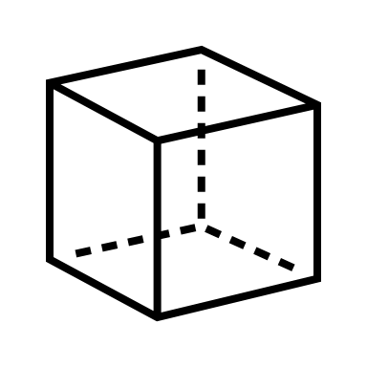
High Fidelity
Lazy SUSAN
Fingerlike
End-Effector
Acrobat LSMS
Christina Morrow
Notes:
Moving on to our high fidelity concepts. Our first one we nicknamed the lazy Susan – this design is a turn-table that would act as a connection point for the LSMS, while it was rotated off of the lander.
Our next high fidelity was the fingerlike end-effector, similar to our medium fidelity concept, however this one would utilize laser technology to locate the LSMS, which would be much more accurate.
Last is the Acrobat LSMS – this concept design was a means of enabling the LSMS to essentially “grab” onto somewhere on the lander and use its own strength to lower itself.

Slide 26
Concept Selection
Pairwise
Comparison
Pugh Chart
+
S
House of
Quality
Analytical
Hierarchy
Process
Christina Morrow
Notes:
Slide idea was taken from https://poweredtemplate.com/four-steps-hiring-process-75689/
So we took these 8 design concepts, the 5 medium and 3 high fidelity and sent them through an iterative concept selection process.
PC – determing the importance weight factor of each of our engineering characteristics
HoQ – we used those weight factors to ranking our engineering characteristics
Pugh – used to elimate concepts compared to a relatively neutral datum
AHP – used to help identify and eliminate bias as well as find our best alternative design

Slide 27
Concept Selection
Priority Characteristics
AUTONOMY
SCALABILITY
WEIGHT
Christina Morrow
Notes:
It’s worth mentioning that our priority characteristics were found to be autonomy, scalability, and weight.
These really influenced the decision making.

Slide 28
High Fidelity
Lazy SUSAN
Christina Morrow

Slide 29
High Fidelity
Lazy SUSAN
Christina Morrow

Slide 30
High Fidelity
Lazy SUSAN
Christina Morrow

Slide 31
High Fidelity
Lazy SUSAN
Christina Morrow

Slide 32
High Fidelity
Lazy SUSAN
Christina Morrow

Slide 33
High Fidelity
Lazy SUSAN
Christina Morrow

Slide 34
High Fidelity
Lazy SUSAN
Christina Morrow

Slide 35
Initial Design
Connection Housing
Actuated Pins & Plug Connection
Revolution Axis
Gearbox and turntable powered through CLPS
lander
Turntable
Gearbox Housing
Ryker Mullinix

Slide 36
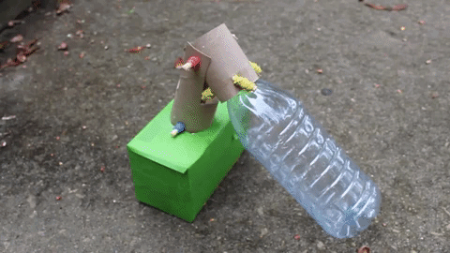
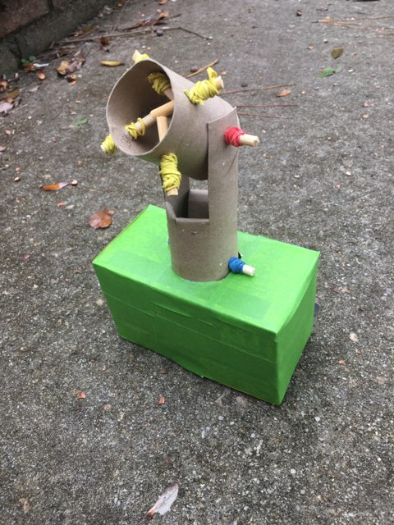
Prototyping
NOTE: For demonstration, the LSMS is represented
using a plastic water bottle.
Ryker Mullinix
Notes:
Put reference axes

Slide 37
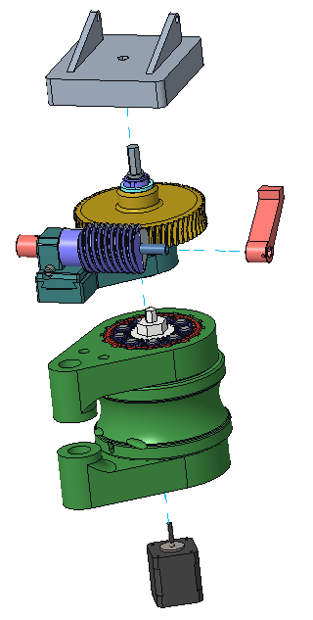
Design 1
1
Turntable / Connection Plate
mates with standard LSMS connector
1
2
Worm Gear Train – converts vertical rotation into horizontal rotation
2
3
3
Coupler Arm – initiates rotation about horizontal axis
4
4
Planetary Gear Train – provides a 160:1 torque ratio
5
Stepper Motor – powered through the lander
5
Ryker Mullinix

Slide 38
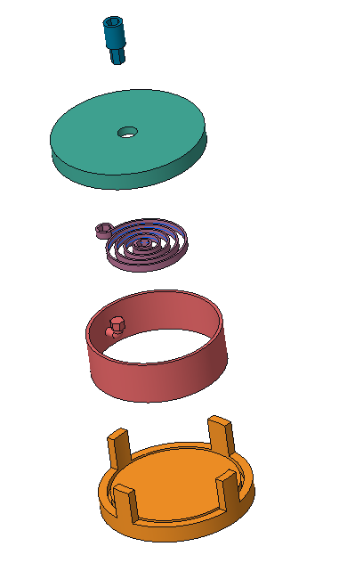
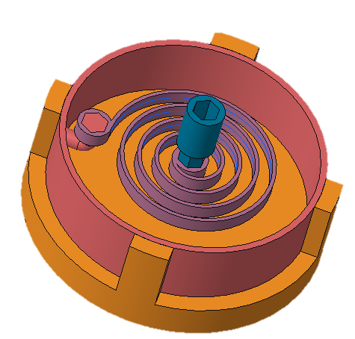
Design 2A
1
1
LSMS Hex Connection – input torque from LSMS winds spiral spring
2
2
Chassis Cover – covers and protects mechanism
3
3
Spiral Torsion Spring – initiates rotation about vertical axis
4
4
Rotational Cylinder – support at least 276 Nm of torque
5
Chassis Bottom – provides support to the slider, has some friction reducing/increasing measure
5
Ryker Mullinix

Slide 39
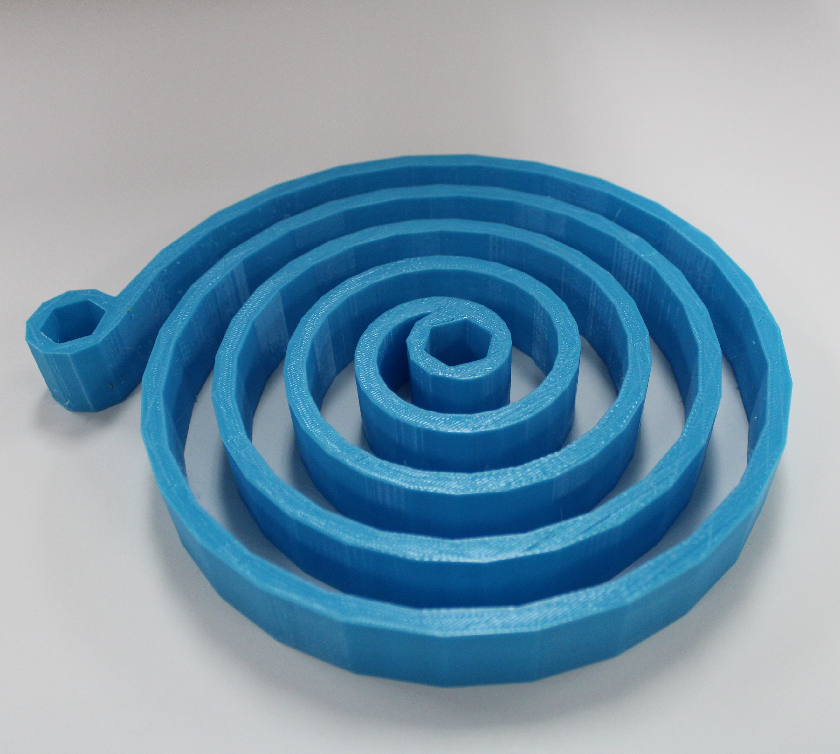
Prototype
Spiral Torsion Spring
no.1
PLA
10%
4.5 oz
Iteration
Material
Infill
Weight
Ryker Mullinix
Notes:
PLA (Polylactic Acid)

Slide 40
Prototype Testing
Applied
Torque
Known
Weight
1.5 oz
3.7 oz
2.5 lbs
5 lbs
0: 0.0
Ryker Mullinix
Notes:
Definitely have testing apparatus, but make an animation to show testing process

Slide 41
Prototype Testing
1.5 oz
3.7 oz
2.5 lbs
5 lbs
Fracture Occurred
at 3.1 lbs
0: 0.0
Ryker Mullinix
Notes:
Definitely have testing apparatus, but make an animation to show testing process

Slide 42
Prototype Errors
LOW
INFILL
PRINT
INCONSISTENCIES
HEAT
TREATMENT
Ryker Mullinix
Notes:
Sources of error for spring
Low infill
Inconsistences in print
Wasn’t heat treated

Slide 43
Testing Errors
WINDING
METHOD
STRING
ELASTICITY
PULLEY
FRICTION
SPRING
FLEX
DISPLACEMENT
ANGLE
Ryker Mullinix
Notes:
Sources of error in testing process:
Tightening of rachet, inconsistent winding method
Yarn/ziptie elasticity
Pulley friction
Spring flexing in z-direction
Didn’t measure displacement angle of connection point

Slide 44
Design 2B
1
Chassis – acts as the ground and provides protection
2
Rotational Cylinder – rotates inside the chassis
3
Linear Tension Springs – initiates rotation about the z-axis
Ryker Mullinix
Notes:
8.5 inch diameter wheel
6 inch length spring
1.5 inch diameter spring
FOS 1.3. This was calculated from the 25lb weight requirement.
This test allowed us to see a rough estimation of how much space we would require for the spring to move without causing interference issues as it retracted.
Or something. BS til it works
NOTE: to replay the animation, hit the [Left Arrow Key] and then the [Right Arrow Key]

Slide 45
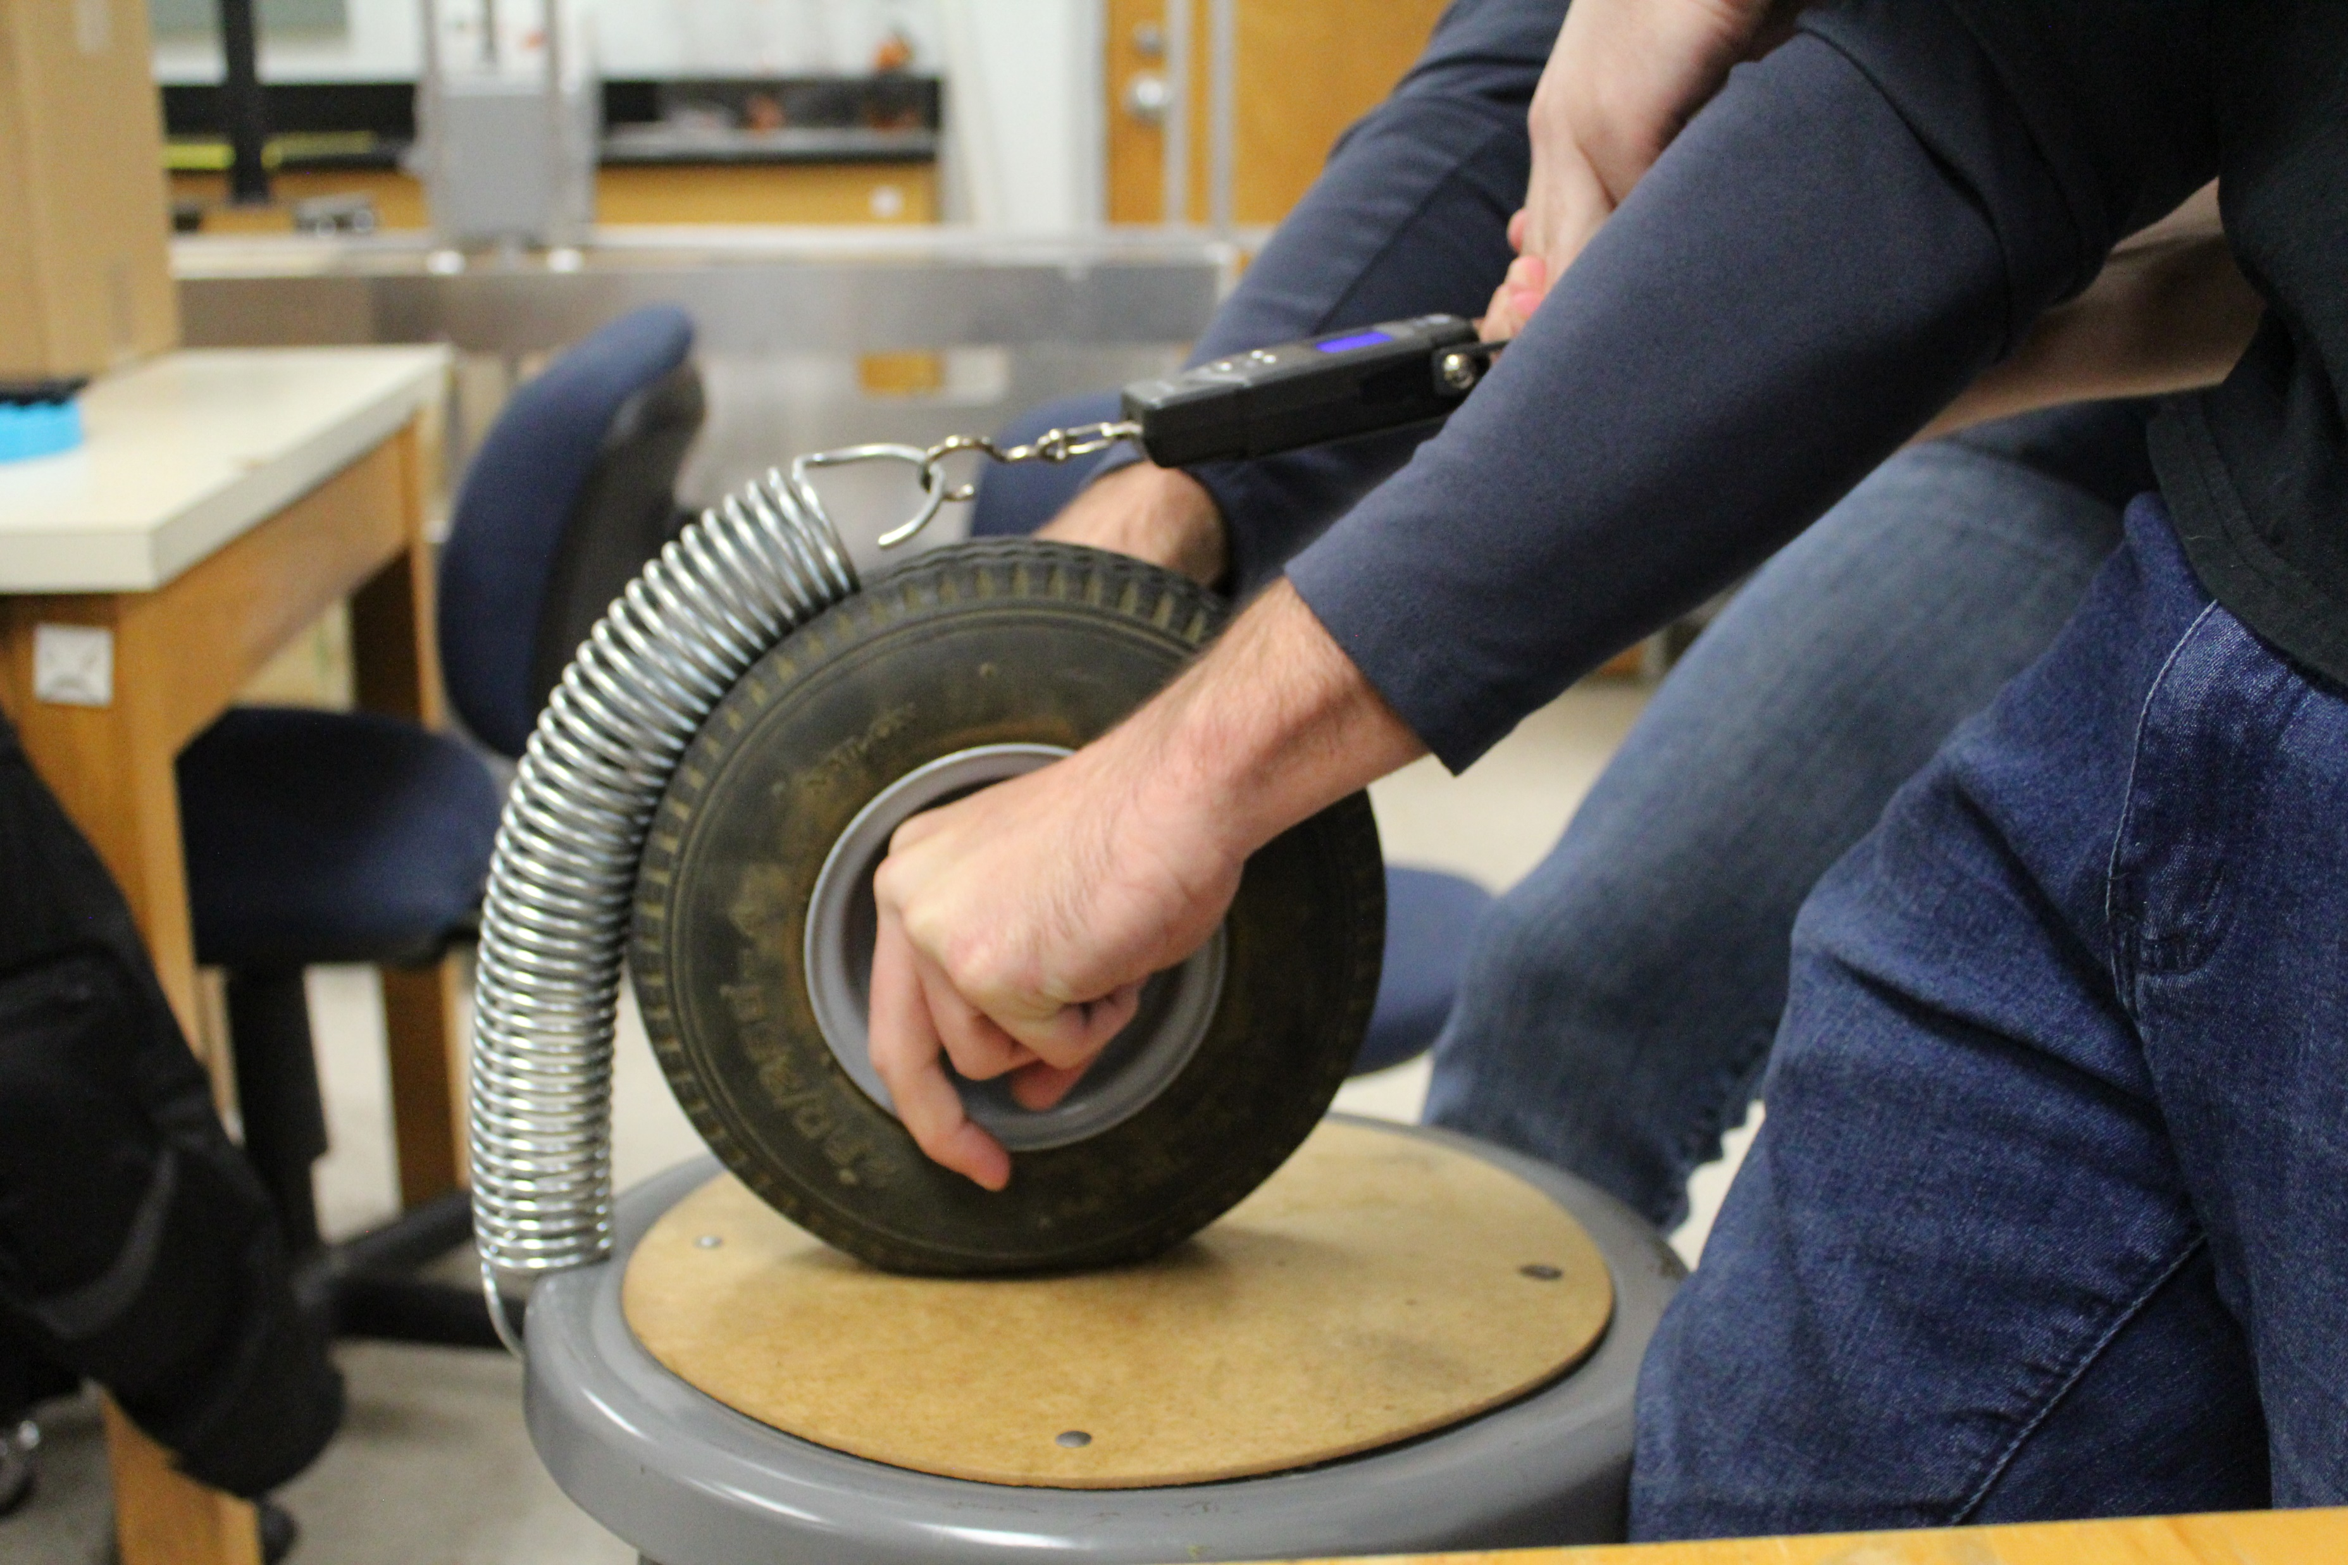
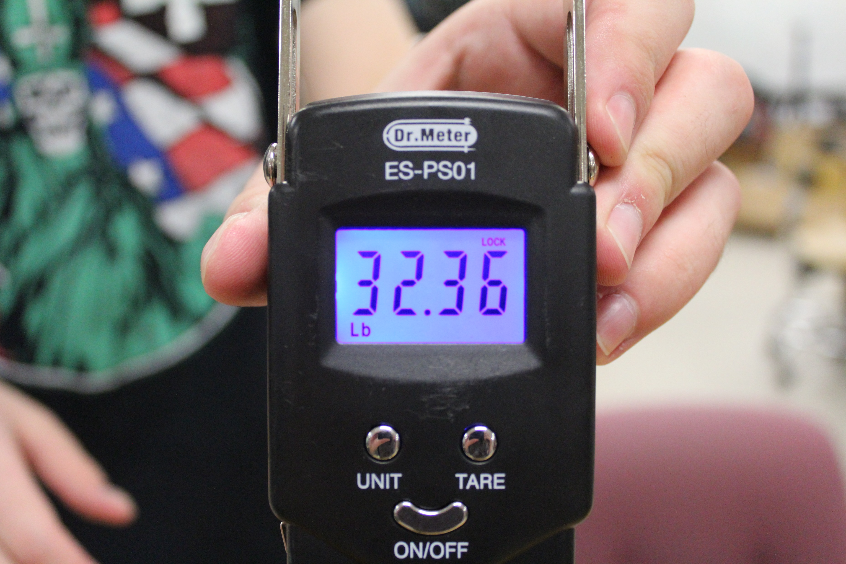
Design 2B Test
Ryker Mullinix
Notes:
8.5 inch diameter wheel
6 inch length spring
1.5 inch diameter spring
FOS 1.3. This was calculated from the 25lb weight requirement.
This test allowed us to see a rough estimation of how much space we would require for the spring to move without causing interference issues as it retracted.

Slide 46
Timeline
Spring Semester Timeline
VDR3
CAD
Automation
VDR4
3D Printing
Prototyping
Testing
Presentation
January
February
March
April
May
Ryker Mullinix
Notes:
NOTES FOR RYKER:
Talk to Hollis
2nd iteration of 3d printed spring
Better testing setup
Default to plan one if parts can't be ordered by the end of January
Start testing the motor + gearbox idea if the torsional spring idea fails
Acquire quote for custom torsional spiral spring
What is the acceptable amount of angular velocity?

Slide 47
TEAM 517
Alanna Black
anb16c@my.fsu.edu
Jayson Dickinson
jpd15e@my.fsu.edu
LUNAR LANDING PAYLOAD CRANE
Christina Morrow
cjm18bn@my.fsu.edu
Ryker Mullinix
rwm18c@my.fsu.edu

Slide 48
References
Dorsey, J., Jones, T., Doggett, W., King, B., Mercer, C., Brady, J., . . . Ganoe, G. (2011). Recent Developments in the Design, Capabilities and Autonomous Operations of a Lightweight Surface Manipulation System and Test-bed. AIAA SPACE 2011 Conference & Exposition. doi:10.2514/6.2011-7266
Doggett, W. (., King, B., Jones, T., Dorsey, J., & Mikulas, M. (2008). Design and Field Test of a Mass Efficient Crane for Lunar Payload Handling and Inspection: The Lunar Surface Manipulation System. AIAA SPACE 2008 Conference & Exposition. doi:10.2514/6.2008-7635
PEREGRINE LUNAR LANDER: PAYLOAD USER’S GUIDE [PDF]. (2020, June). Astrobotic Technology.
Jefferies, S., Doggett, W., Chrone, J., Angster, S., Dorsey, J., Jones, T., . . . Caldwell, D. (2010). Lunar Lander Offloading Operations Using a Heavy-Lift Lunar Surface Manipulator System. AIAA SPACE 2010 Conference & Exposition. doi:10.2514/6.2010-8804
Dorsey, J., Jones, T., Doggett, W., King, B., Mikulas, M., & Roithmayr, C. (2009). Developments to Increase the Performance, Operational Versatility and Automation of a Lunar Surface Manipulation System. AIAA SPACE 2009 Conference & Exposition. doi:10.2514/6.2009-6795
Dorsey, J., Mikulas, M., & Doggett, W. (2008). Preliminary Structural Design Considerations and Mass Efficiencies for Lunar Surface Manipulator Concepts. AIAA SPACE 2008 Conference & Exposition. doi:10.2514/6.2008-7916

Slide 49
Background Info - Artemis
Artemis Mission Milestones:
Scheduled to Launch in 2023
Sending the next man and first woman to the moon
Major goal is to set up a lunar base
Photos from nasa.gov

Slide 50
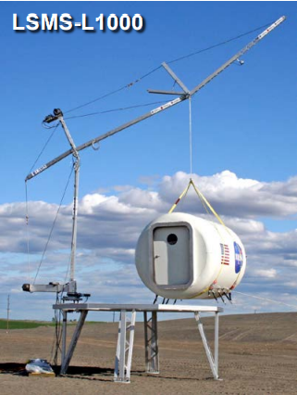
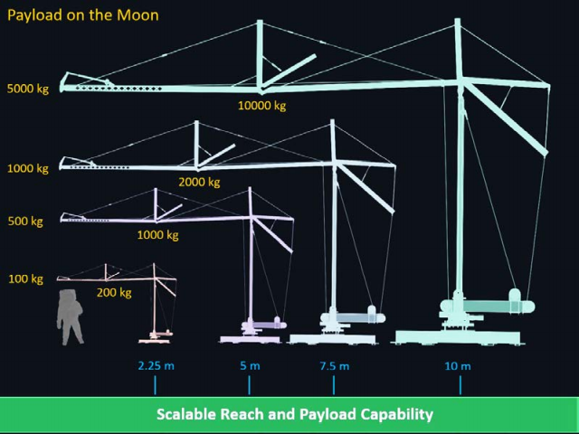
Background Info - LSMS
Versatile and Multi-Functional:
Precision Payload Lifting / Unloading
Large-Scale 3-D Printing
Assembly, and Regolith Excavation and Handling
Astronaut Elevator
Deploying Structures + Science
Connections, E-Beam Welding
NASA LSMS Crane
Info and Photos from Presentation Given by Tom Jones

Slide 51
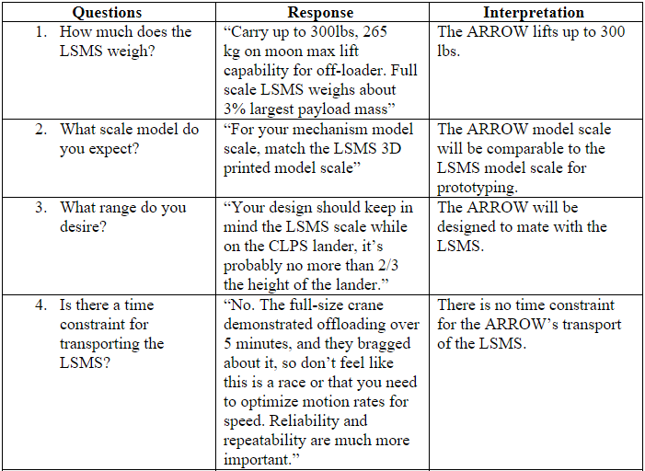
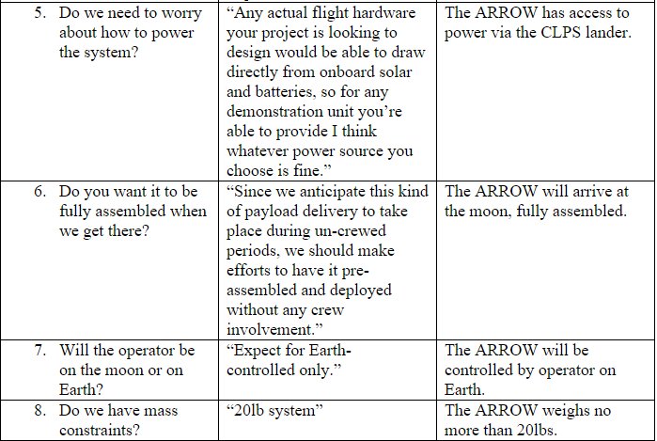
Customer Needs (new)

Slide 52
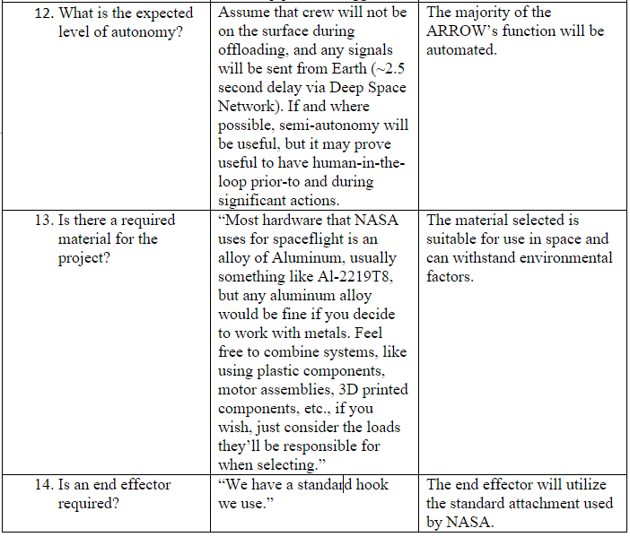
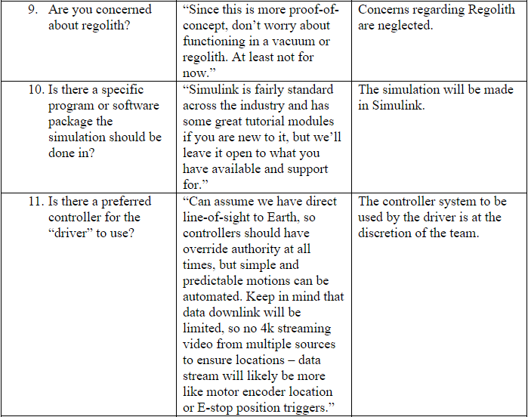
Customer Needs (new)

Slide 53
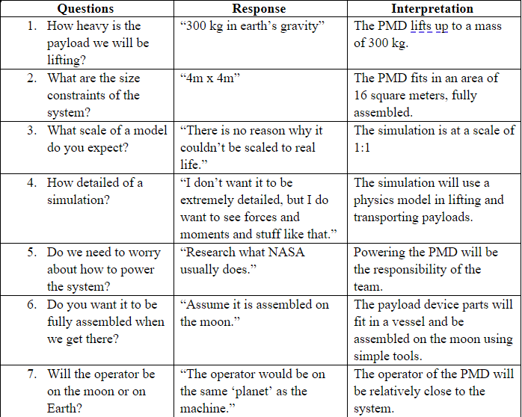
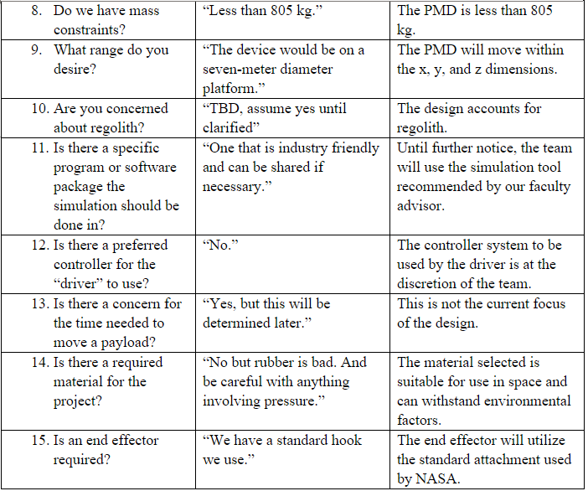
Customer Needs (old)

Slide 54
Customer Needs
How much does the LSMS weigh?
Is there a time constraint for transporting the LSMS?
What is the expected level of autonomy?
What scale should be used?
The ARROW will lift up to 25 lbs.
There is no time constraint for transport of the LSMS.
Automation for offloading will be part of the landing sequence.
The ARROW will be scalable to mate with the LSMS.
Christina Morrow

Slide 55
Key Goals – SAE Standards

Slide 56
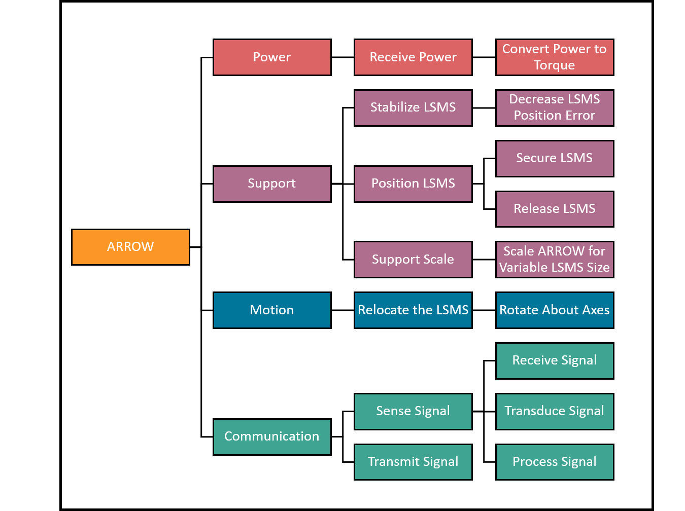
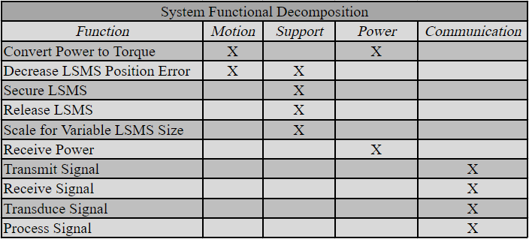
Functional Decomposition (new)
Cross Reference Table
Hierarchy Flow Chart

Slide 57
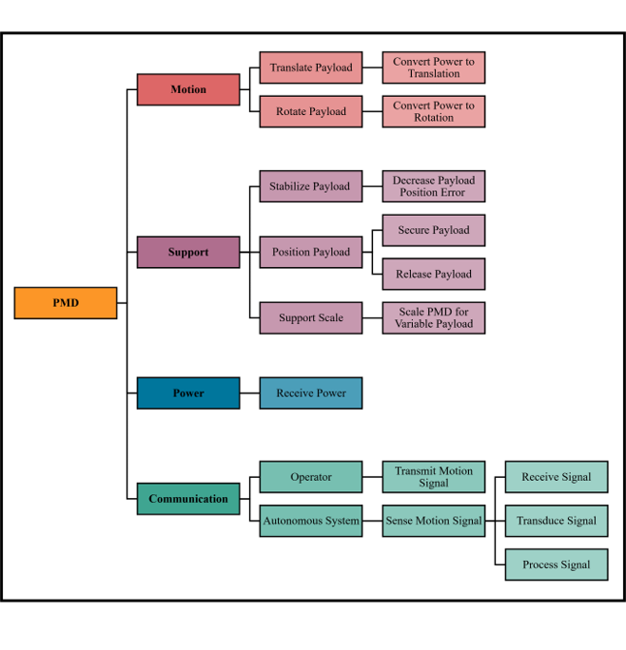
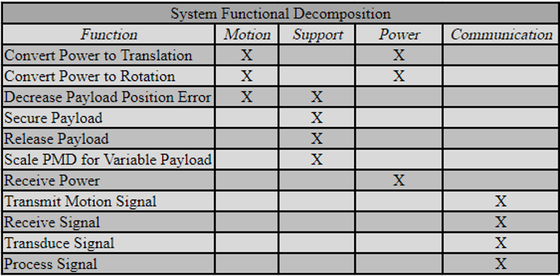
Functional Decomposition (old)
Cross Reference Table
Hierarchy Flow Chart

Slide 58
Targets & Metrics

Slide 59
High Fidelity
Fingerlike
End-Effector
Jayson Dickinson

Slide 60
High Fidelity
Fingerlike
End-Effector
Jayson Dickinson

Slide 61
High Fidelity
Fingerlike
End-Effector
Jayson Dickinson

Slide 62
High Fidelity
Fingerlike
End-Effector
Jayson Dickinson

Slide 63
High Fidelity
Fingerlike
End-Effector
Jayson Dickinson

Slide 64
High Fidelity
Fingerlike
End-Effector
Jayson Dickinson

Slide 65
High Fidelity
Acrobat LSMS
Jayson Dickinson

Slide 66
High Fidelity
Acrobat LSMS
Jayson Dickinson

Slide 67
High Fidelity
Acrobat LSMS
Jayson Dickinson

Slide 68
High Fidelity
Acrobat LSMS
Jayson Dickinson

Slide 69
High Fidelity
Acrobat LSMS
Jayson Dickinson

Slide 70
High Fidelity
Acrobat LSMS
Jayson Dickinson

Slide 71
High Fidelity
Acrobat LSMS
Jayson Dickinson

Slide 72
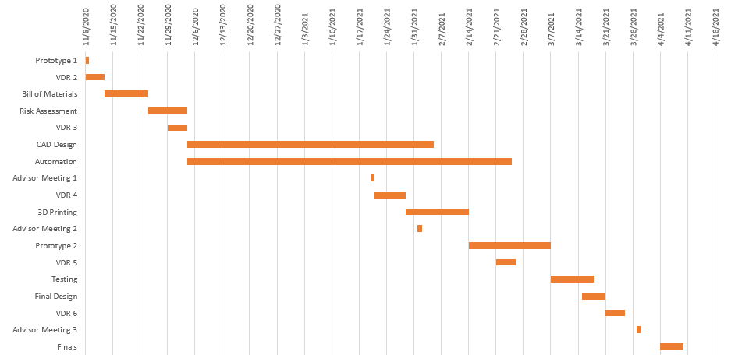
Gantt Chart

Slide 73
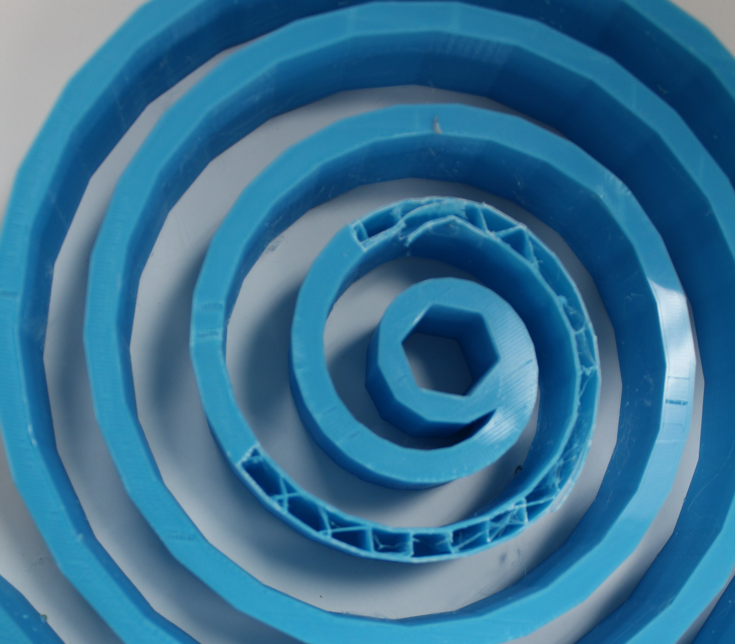
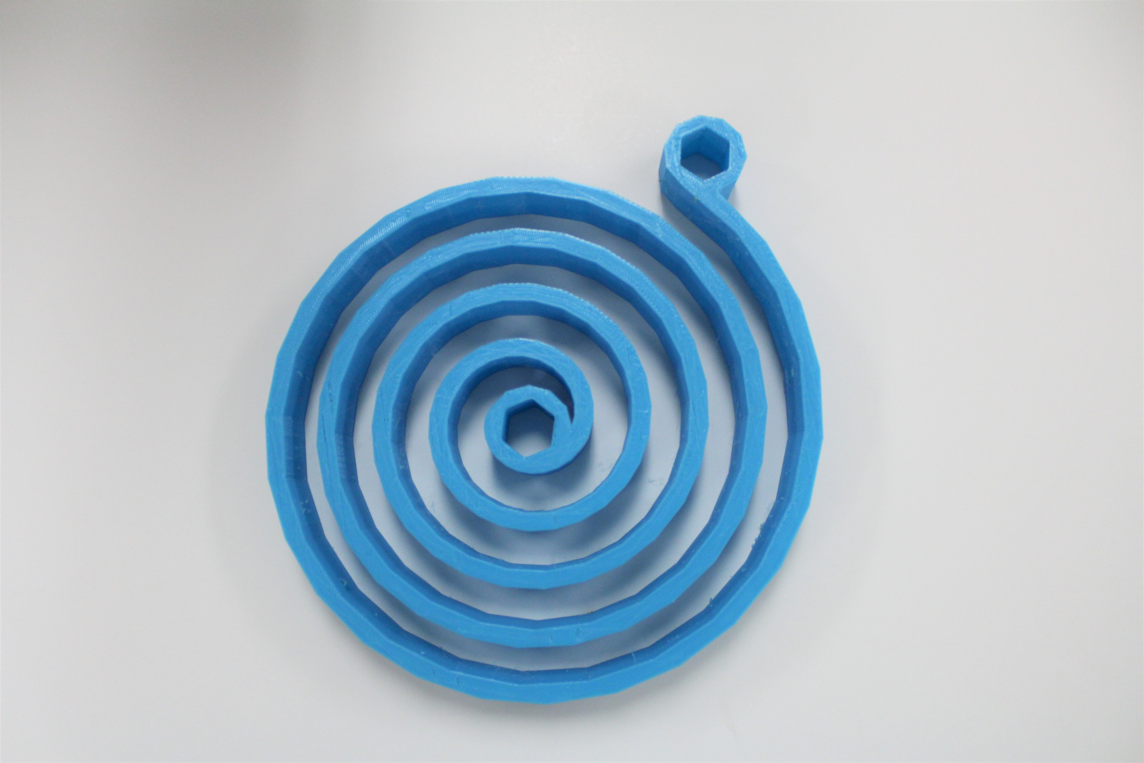
Prototype Testing
8in
Spiral torsion spring iteration no.1, printed with PLA at 10% infill.
Not heat treated.

Slide 74
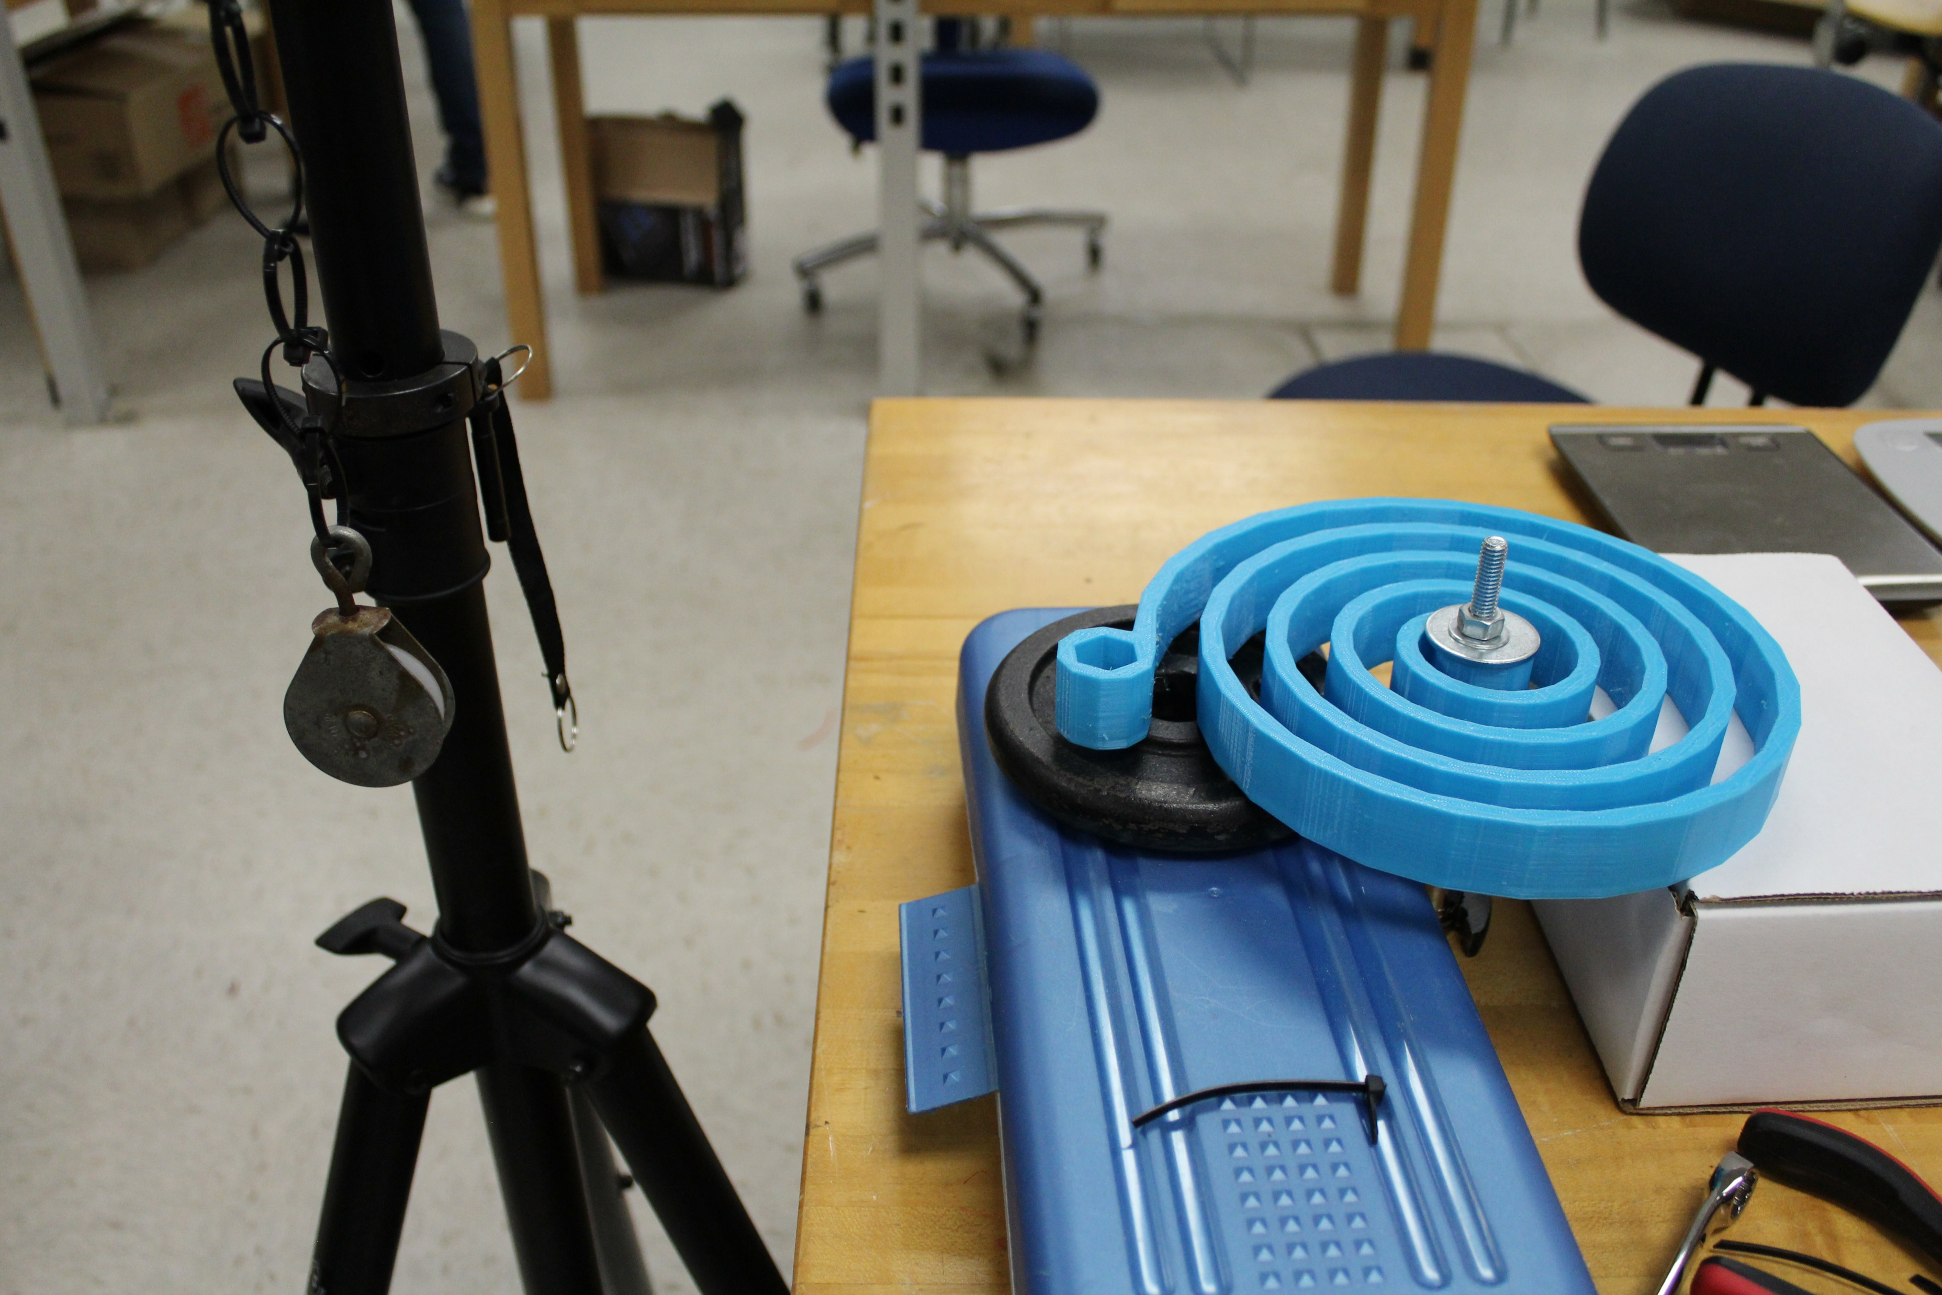
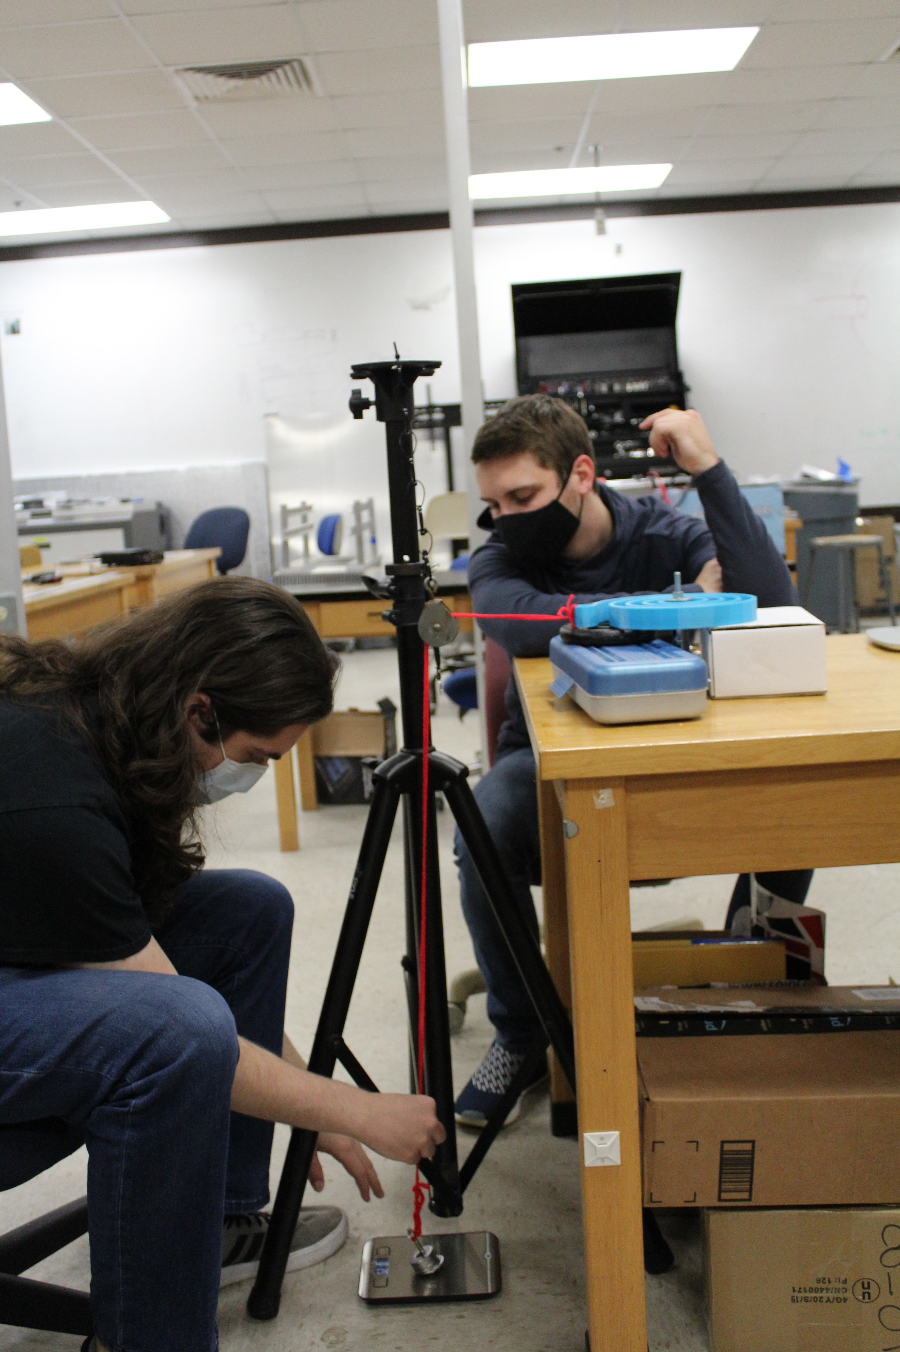
Testing Apparatus
Testing apparatus to gauge the strength of the 3D printed torsion spring.

Slide 75
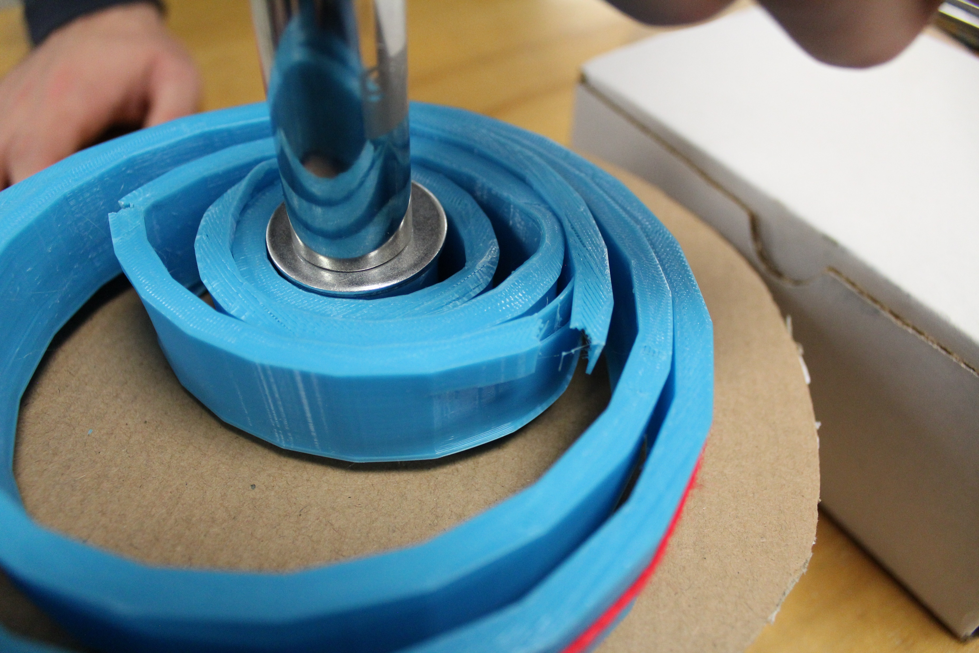
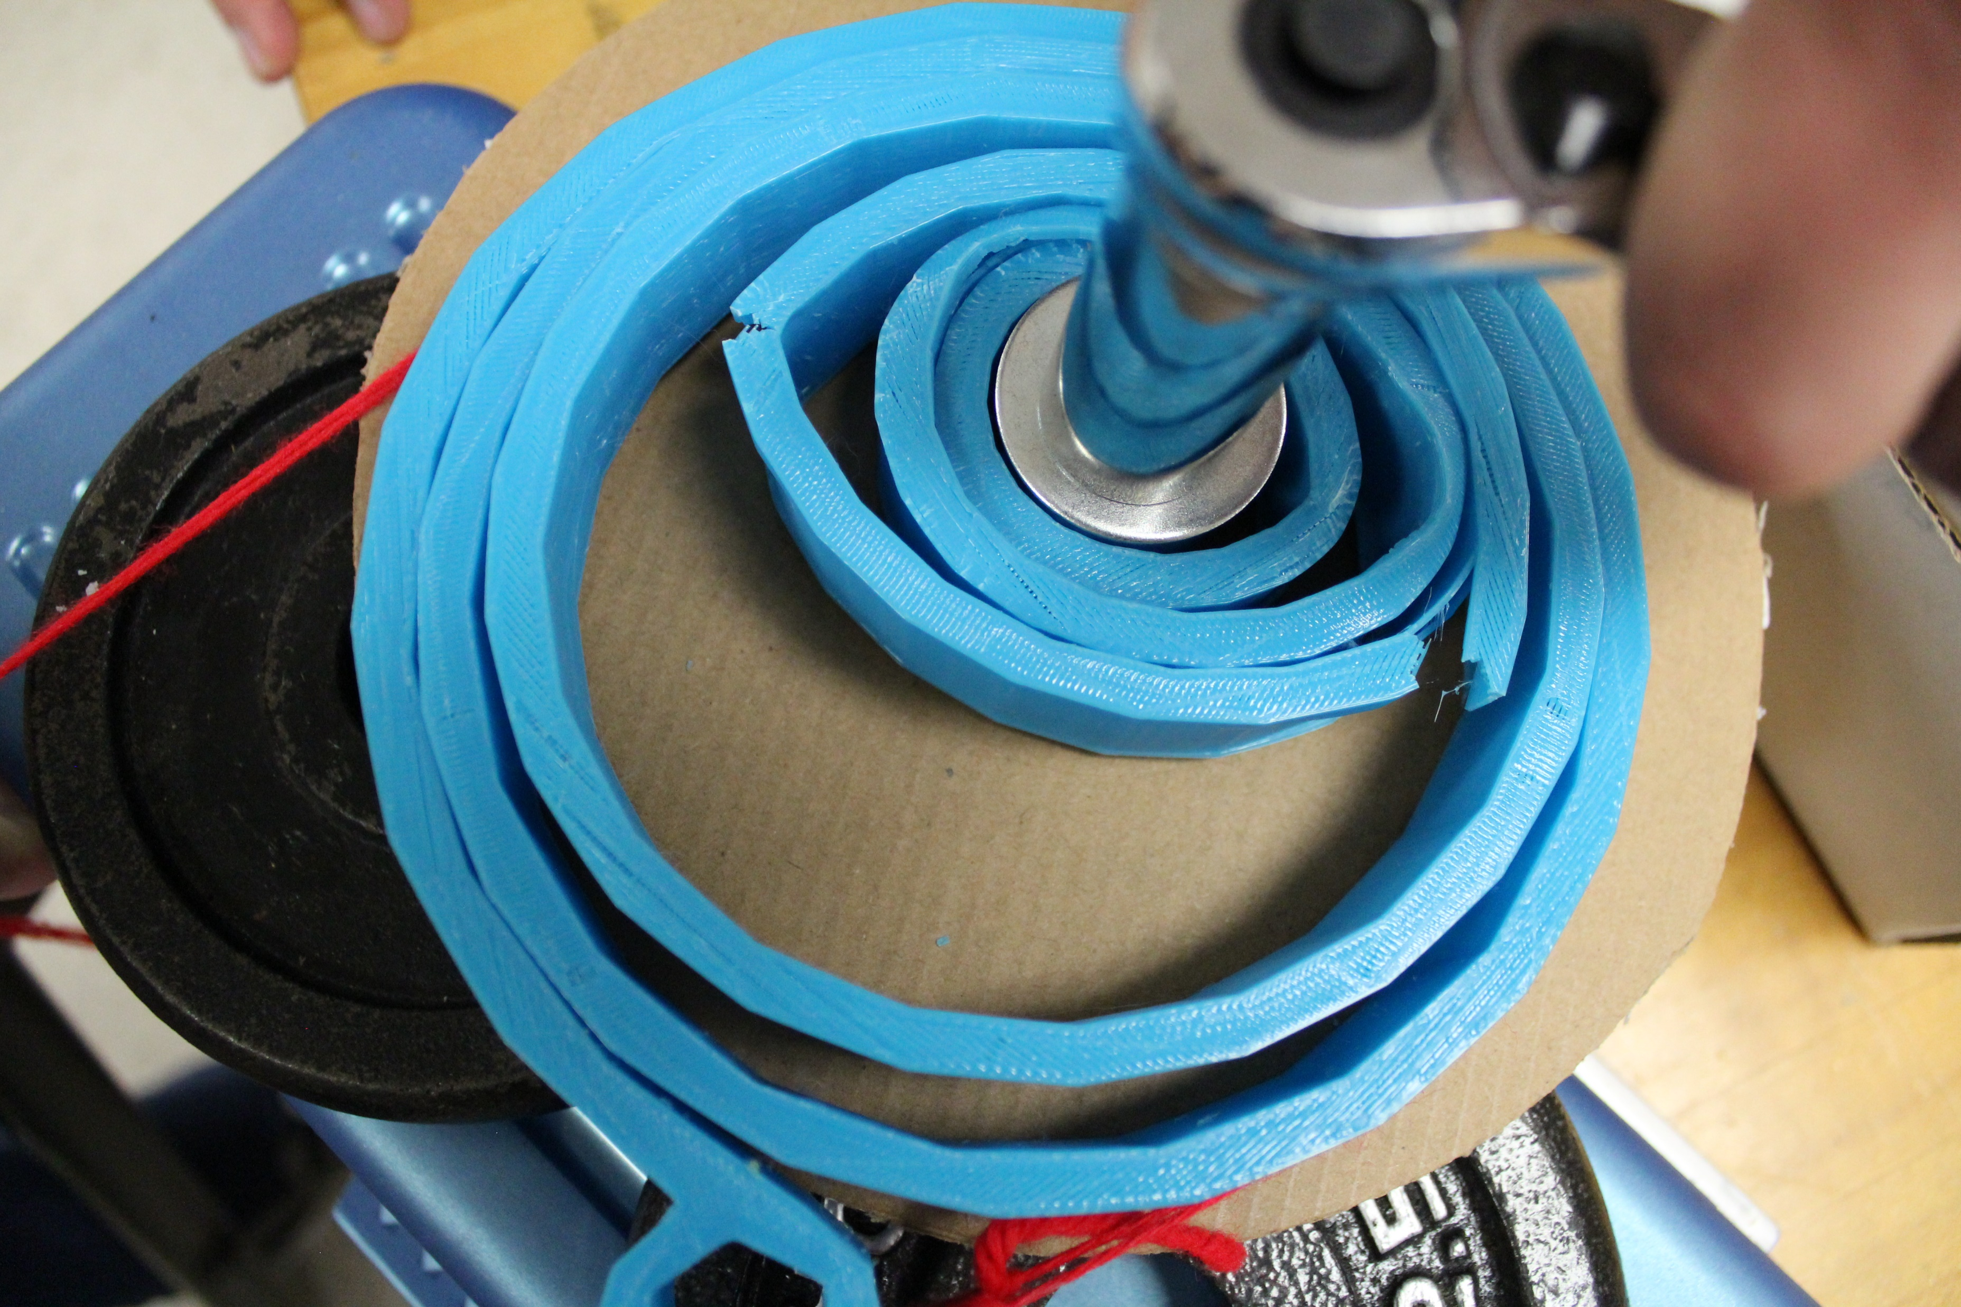
Fracture Point
Failure Occurred at 3.1 lbs
Notes:
Results, show fracture

Slide 76
Color Palette

Slide 77
Team 517 Icons
Lunar Base Module
Straight Spring
ARROW
Rotate about Z-axis
CLPS Lander
LSMS
Mobility Chassis
1.9m
Ryker

